Slide 1

Review: Paper Reading K-BERT: Enabling Language Representation With Knowledge Graph
范老师
2020/07/12

Slide 2
Content
Introduction
Related Work
Methodology
Experiments
Conclusion

Slide 3
Introduction
大背景：Due to the domain-discrepancy between pre-training and fine-tuning, these models do not perform well on knowledge-driven tasks. 即， BERT这种预训练模型对于领域相关的推理比较。
方案：
• This paper proposes a knowledge-enabled LR model, namely K-BERT, which is compatible with BERT and can incorporate domain knowledge without HES and KN issues;
• With the delicate injection of KG, K-BERT significantly outperforms BERT not only on domain-specific tasks, but also plenty of those in the open-domain;
• The codes of K-BERT and our self-developed knowledge graphs are publicly available at https://github.com/autoliuweijie/K-BERT.

Slide 4
Related Work
How pre-training process is evolved
How pre-trained LR models are combined with KG, but result in low efficiency
How KG is combined with word vectors
The major weakness of these methods is that they are still based on the idea of “word2vec + transE” (Bordes et al. 2013), rather than the pre-trained LR model.
Although they use the method of joint representation to make the vector space of entities and words closer, there are still HES problems.
What’s more, for KGs with millions of entities, this idea makes the entity table very large, making it unusable because it exceeds the GPU’s memory size.

Slide 5
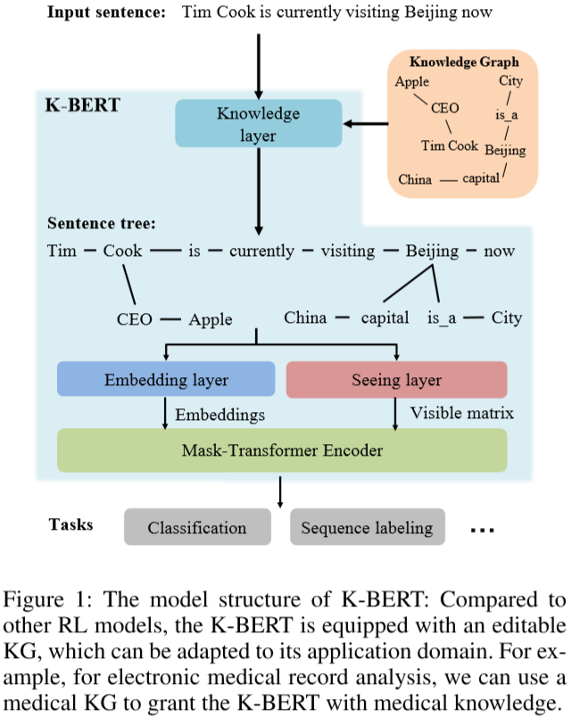
Methodology – Model Architecture

Slide 6
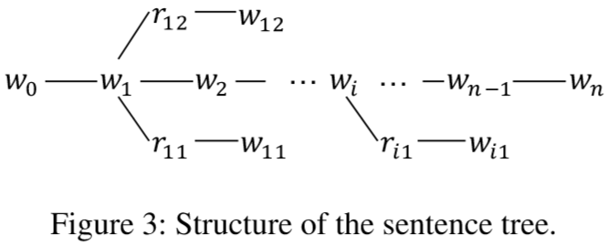
Methodology – Knowledge Layer
In K-Query, all the entity names involved in the sentence s are selected out to query their corresponding triples from K.
K-Inject injects the queried E into the sentences by stitching the triples in E to their corresponding position, and generates a sentence tree t. The structure of t is illustrated in Figure 3.

Slide 7
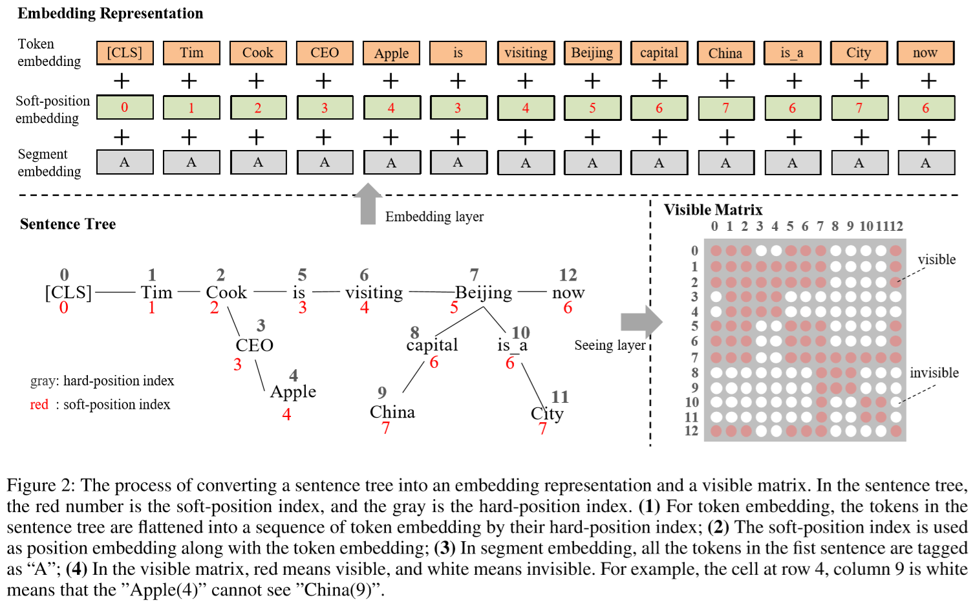
Methodology – Embedding Layer and Hard Layer

Slide 8
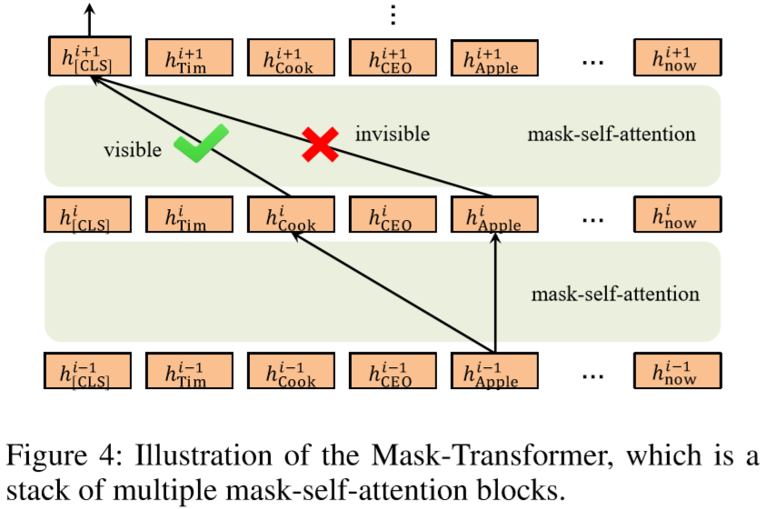
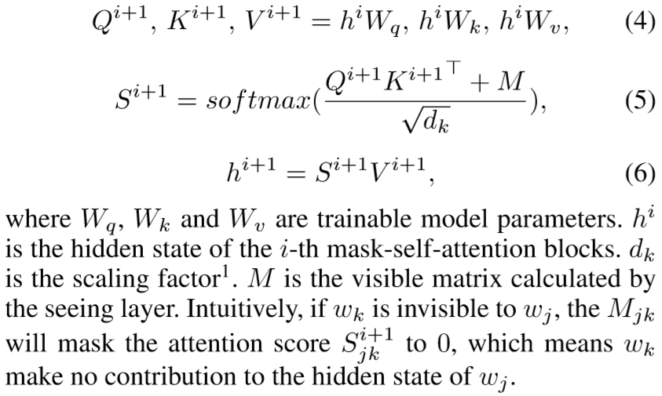
Methodology – Transformer Layer

Slide 9
Experiments – Settings
Pre-training corpora: WikiZh, WebtextZh
Knowledge graph: CN-Dbpedia, HowNet, MedicalKG
Baselines: Google BERT, Our BERT
Parameter settings and training details
We denote the number of (mask-)self-attention layers and heads as L and A respectively, and the hidden dimension of embedding vectors as H. In detail, we have the following model configuration: L = 12, A = 12 and H = 768.
One thing to emphasize is that we don’t add any KG to K-BERT during the pre-training phase. Because KG binds two related entity names together, thus making the pre-trained word vectors of the two are very close or even equal and resulting in a semantic loss. KG will be enabled during the fine-tuning and inferring phases.

Slide 10
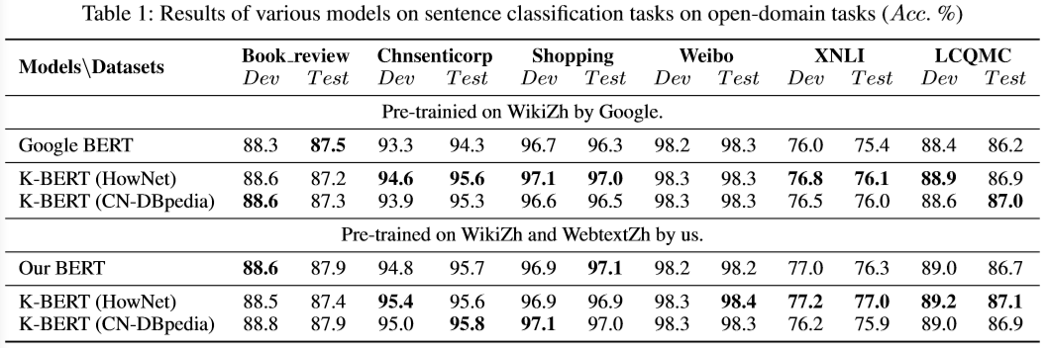
Experiments – Open-domain Tasks
(1) The KG has no significant effect on the tasks of sentiment analysis (i.e., Book review, Chnsenticorp, Shopping and Weibo) because the sentiment of a sentence can be judged based on emotional words without any knowledge;
(2) The language KG (HowNet) performs better than the encyclopedic KG in terms of semantic similarity tasks(i.e., XNLI and LCQMC);

Slide 11
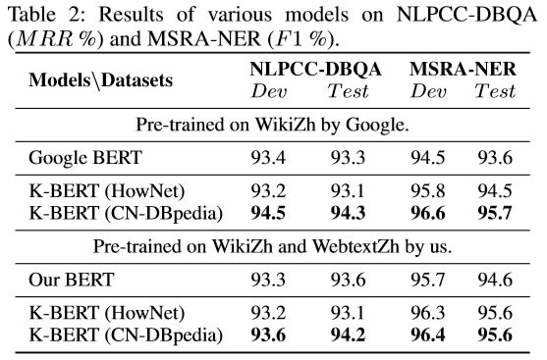
Experiments – Open-domain Tasks
(3) For Q&A and NER tasks (i.e., NLPCC-DBQA and MSRA-NER), the encyclopedic KG (CN-DBpedia) is more suitable than the language KG. Therefore, it is important to choose the right KG based on the type of task.

Slide 12
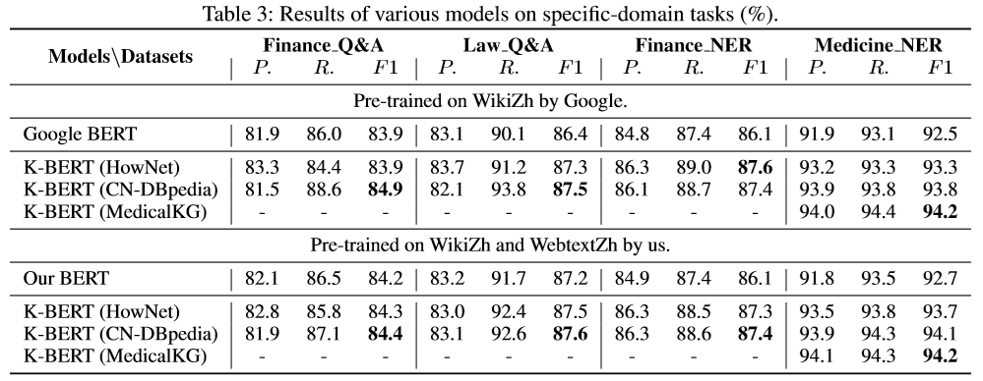
Experiments – Specific-domain Tasks
Compared with BERT, K-BERT has a significant performance improvement in terms of domain tasks. As for F1, K-BERT with CN-DBpedia can improve the performance of all tasks by 1∼2%.
Furthermore, it can be observed from the Medicine NER in Table 3 that the performance improvement using the Medical KG is very obvious.

Slide 13
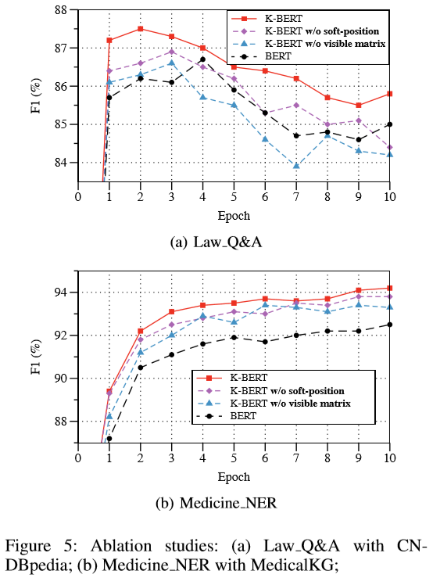
Experiments – Ablation Studies
In both tasks, without soft-position or visible matrix, the performance of K-BERT has declined;
In Law Q&A (Figure5(a)), K-BERT without visible matrix is worse than BERT, which confirms the existence of KN, i.e., improperly adding knowledge can lead to performance degradation;
In Figure 5(a), K-BERT reaches its peak at epoch 2, while BERT is at epoch 4, which proves that K-BERT converges faster than BERT.

Slide 14
Conclusion
In this paper, we propose K-BERT to enable language representation with knowledge graphs, achieving the capability of commonsense or domain knowledge. Specifically, K-BERT first injects knowledge from KG into a sentence, making it a knowledge-rich sentence tree. Next, soft-position and visible matrix are adapted to control the scope of knowledge, preventing it from deviating from its original meaning.
Besides, K-BERT is compatible with the model parameters of BERT, which means that users can directly adopt the available pre-trained BERT parameters (e.g., Google BERT, Baidu-ERNIE, etc.) on K-BERT without pre-training by themselves.
These positive results point to future work in (1) improving K-Query to enable filtering of unimportant triples based on context; (2) extending this approach to other LR models such as ELMo (Peters et al. 2018), XLNet (Yang et al. 2019), etc;

Slide 15
Reference
[1] TranE：https://zhuanlan.zhihu.com/p/63958966
https://github.com/autoliuweijie/K-BERT

Slide 16
Thanks!

